Slide 1
EDA Assignment
Data Science Course
Jigsaw user Id: veeranna.mh@gmail.com

Slide 2
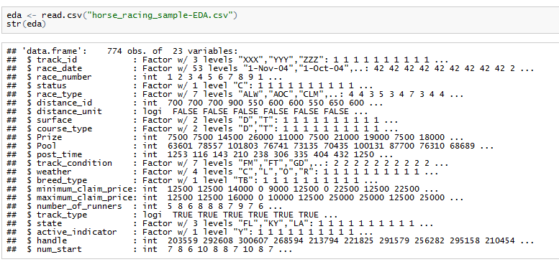
EDA: Horse Racing

Slide 3
EDA: Horse Racing
Sl.No. | variables | type | factor levels | classification | Remarks
1 | track_id | factor | 3 | QLT | XXX, YYY, ZZZ
2 | race_date | factor | 53 | date | By default any character variable in R is treated as "Factor"
3 | race_number | integer |  | QNT
4 | status | factor | 1 | QLT
5 | race_type | factor | 7 | QLT | ALW: allowance, AOC: allowance optional claiming, CLM: claiming, MCL: maiden claiming, MSW: maiden special weight, STK: stakes, STR: starter allowance
6 | disytance_id | integer |  | QNT
7 | distance_unit | logical |  | logical | ??? distance unit code "F" might have been interpreted by R as "False" which is logical variable. But distance unit is Furlong.
8 | surface | factor | 2 | QLT | dirt, turf
9 | course_type | factor | 2 | QLT | dirt, turf
10 | Prize | integer |  | QNT
11 | Pool | integer |  | QNT
12 | post_time | integer |  | QNT
13 | track_condition | factor | 7 | QLT | FM: firm, FT: fast, GD: good, MY: muddy, SY: sloppy, WF: wet fast, YL: yielding
14 | weather | factor | 4 | QLT | C: clear, L: cloudy, O: showery, R: rainy
15 | breed_type | factor | 1 | QLT
16 | minimm_claim_price | integer |  | QNT
17 | maximum_claim_price | integer |  | QNT
18 | number_0f_runners | integer |  | QNT
19 | track_type | logical |  | logical | ??? Track type "T" might have been interpreted by R as logical variable. But "T" represents "Thoroughbred"
20 | state | factor | 3 | QLT | FL: Florida, KY: Kentucky, LA: Louisiana
21 | active_indicator | factor | 1 | QLT
22 | handle | integer |  | QNT
23 | num_start | integer |  | QNT | could not find meaning (and utility) of this variable

Slide 4
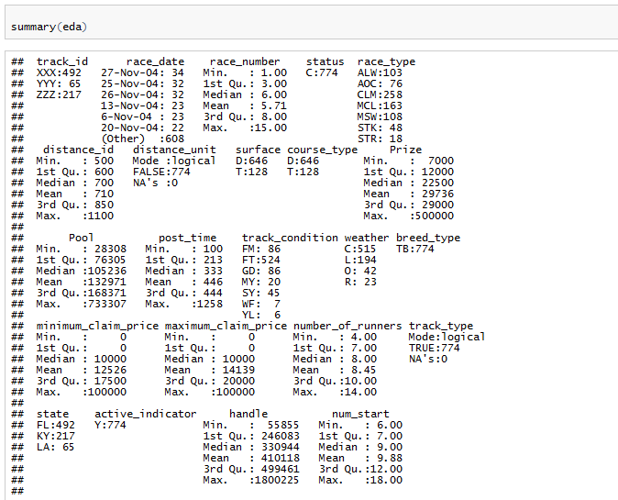
EDA: Horse Racing
No missing values in the dataset
Breed type is TB for all 774 which is correct as this is data of thoroughbred horse racing

Slide 5
EDA: Horse Racing
There are 774 observations of 23 variables.
There are no missing values in the sample dataset.
Status shows “C” for all 774 observations. In data dictionary definition of “status” is not given. Does “C” indicates completed races? To be clarified.
Distance unit is being shown as logical variable with “False” logical value for all 774 observations. Distance unit code “F” might have been interpreted by R as logical variable. Distance unit code “F” represents “Furlongs”. Still it is better to clarify.
Similarly, track type is also shown as logical variable with all 774 observations having “T”. Again in this case, “T” value may be misinterpreted by R, which in reality may be code for “Thoroughbred” track type. Still it is better to clarify.

Slide 6
EDA: Horse Racing
Breed type is TB:774 indicating, in all 774 races, breed type is “Thoroughbred”, which is expected since the sample data is of thoroughbred horse racing.
Active indicator Y:774, indicated “Yes” for all 774 observations. But definition of active indicator is not available in data dictionary. Active indicator Y/N is shown in the table “track” in the data dictionary. It may be related to whether track is active or not. To be clarified.
Exploratory data analysis is done in the following slides. One point to mention here is, in all the cases, outliers or extreme data points need to be analyzed in depth (which is not done in this ppt)
Both Excel and R have been used for EDA.

Slide 7
EDA: Horse Racing

Slide 8
EDA: Horse Racing
Race Type
ALW | ALLOWANCE
AOC | ALLOWANCE OPTIONAL CLAIMING
CLM | CLAIMING
MCL | MAIDEN CLAIMING
MSW | MAIDEN SPECIAL WEIGHT
STK | STAKES
STR | STARTER ALLOWANCE

Slide 9
EDA: Horse Racing

Slide 10
EDA: Horse Racing
FL: Florida
KY: Kentucky
LA: Louisiana

Slide 11
EDA: Horse Racing
FM: firm
FT: fast
GD: good
MY: muddy
SY: sloppy
WF: wet fast
YL: yielding

Slide 12
EDA: Horse Racing
C: clear
L: cloudy
O: showery
R: rainy

Slide 13
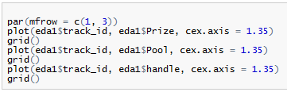
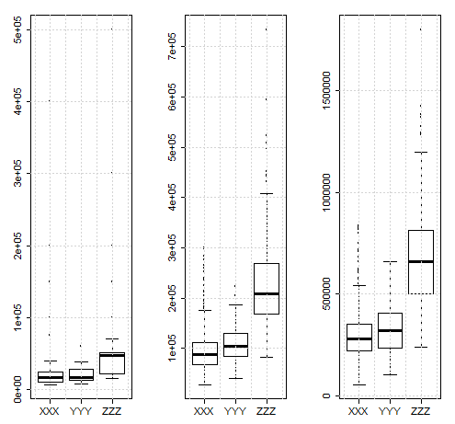
EDA: Horse Racing
Prize, Pool and handle are considerable higher for track_Id ZZZ and are least for track_id XXX among the three.
Note: Heights of the graphs are not proportionately scaled

Slide 14
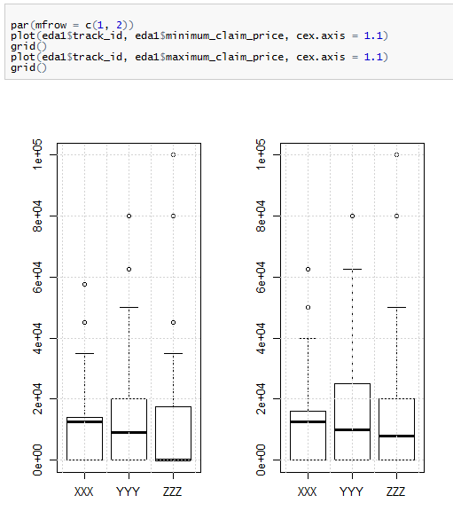
EDA: Horse Racing
Minimum and maximum claim prices are lesser for track_Id ZZZ, even though a couple of high points (data) are observed.

Slide 15
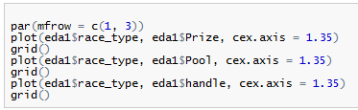
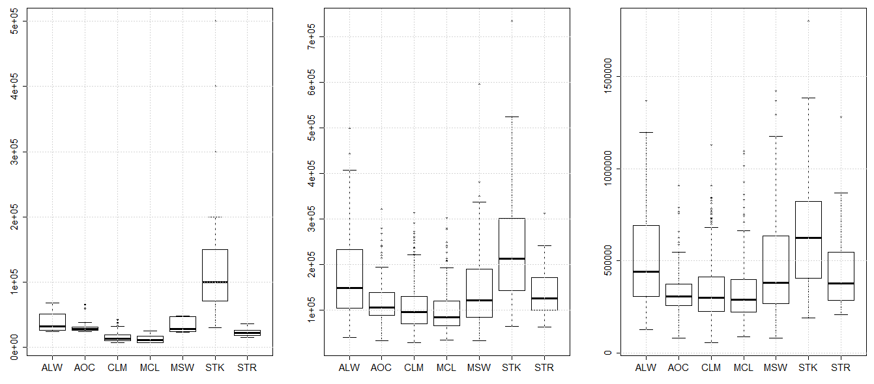
EDA: Horse Racing
Prize, Pool and handle are considerable higher for “stakes” race type and are least for “maiden claiming” race type.
Note: Heights of the graphs are not proportionately scaled

Slide 16

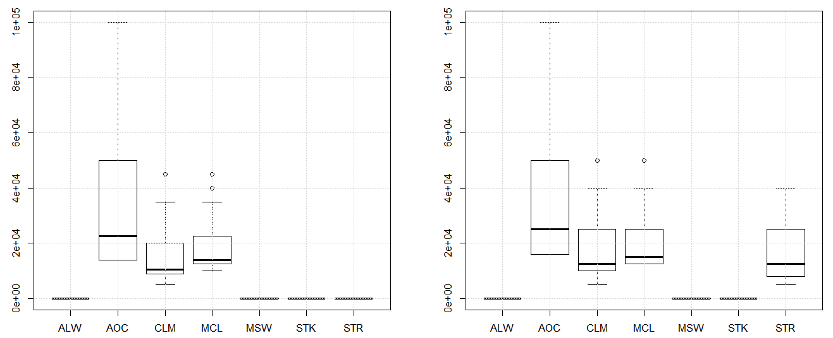
EDA: Horse Racing
Minimum and maximum claim prices for some of the race types are depicted at “zero” in the graphs. Needs further exploration. Some extreme points are observed for “allowance optional claiming” race type.

Slide 17
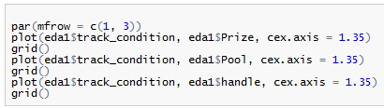
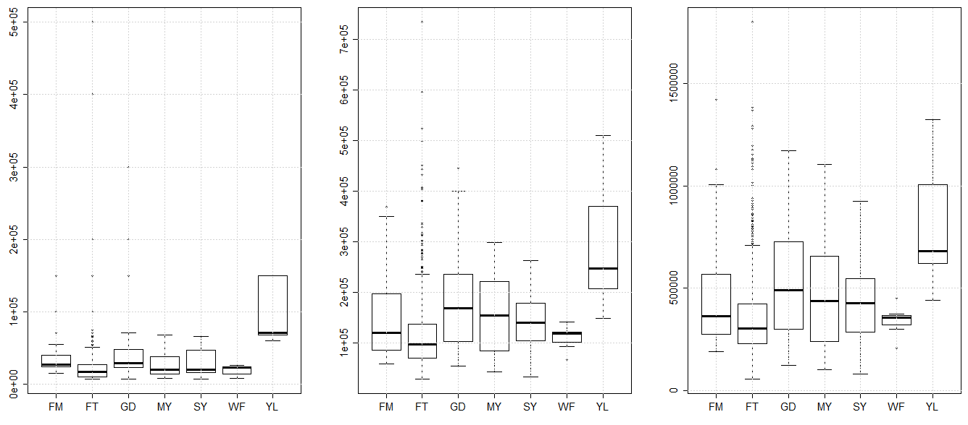
EDA: Horse Racing
Prize, Pool and handle are significantly higher for “yielding” track condition.
Note: Heights of the graphs are not proportionately scaled

Slide 18

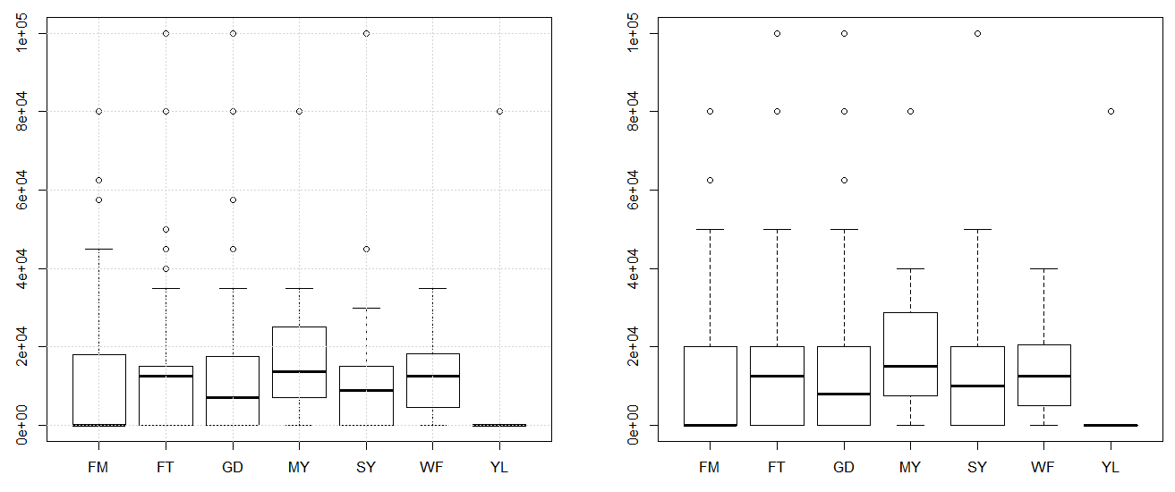
EDA: Horse Racing
Minimum and maximum claim prices for “yielding” track condition are being depicted at “zero” in the graph (but there is an extreme observation in each case).

Slide 19
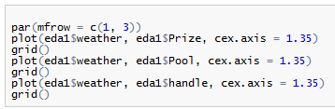
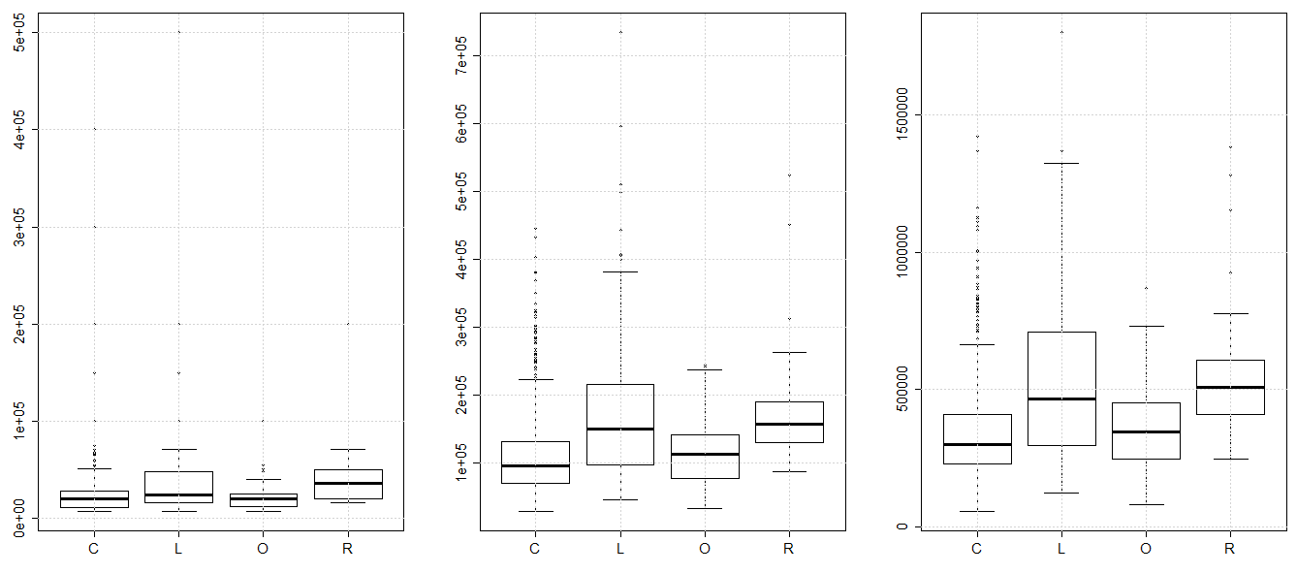
EDA: Horse Racing
Prize, Pool and handle are higher for “rainy” weather condition and also for “cloudy” weather condition.
Note: Heights of the graphs are not proportionately scaled

Slide 20

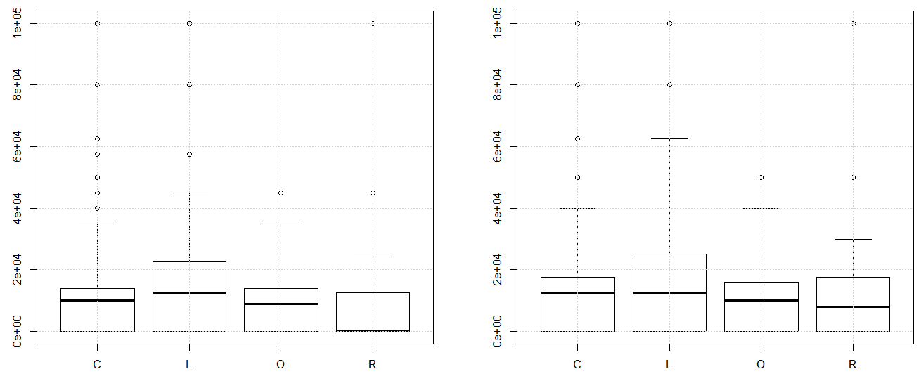
EDA: Horse Racing
Median minimum claim prices for “rainy” weather condition is zero. In other three cases there seems to be no much difference between minimum and maximum claim price.

Slide 21
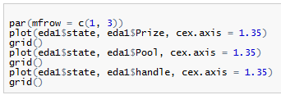
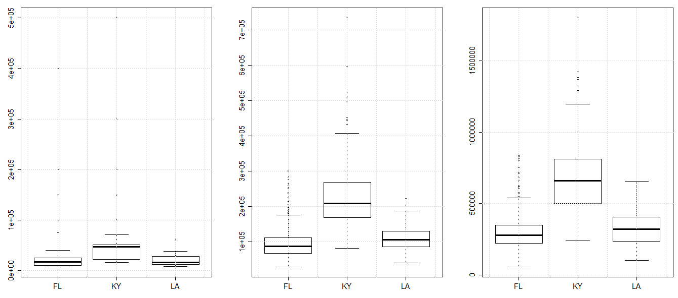
EDA: Horse Racing
Prize, Pool and handle are significantly higher for “Kentucky” state compared to other two.
Note: Heights of the graphs are not proportionately scaled

Slide 22

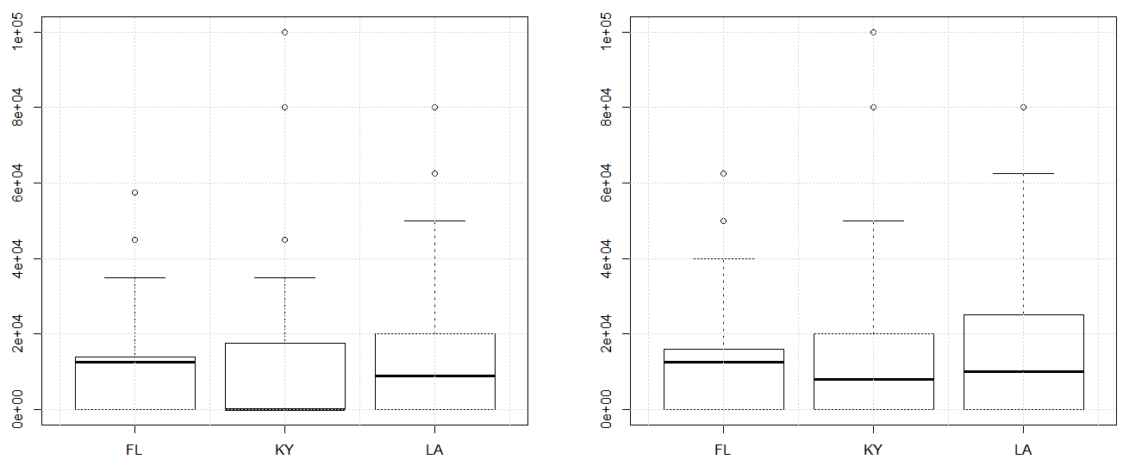
EDA: Horse Racing
Median minimum and maximum claim prices are relatively lower for Kentucky state compared to other two.

Slide 23
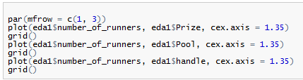
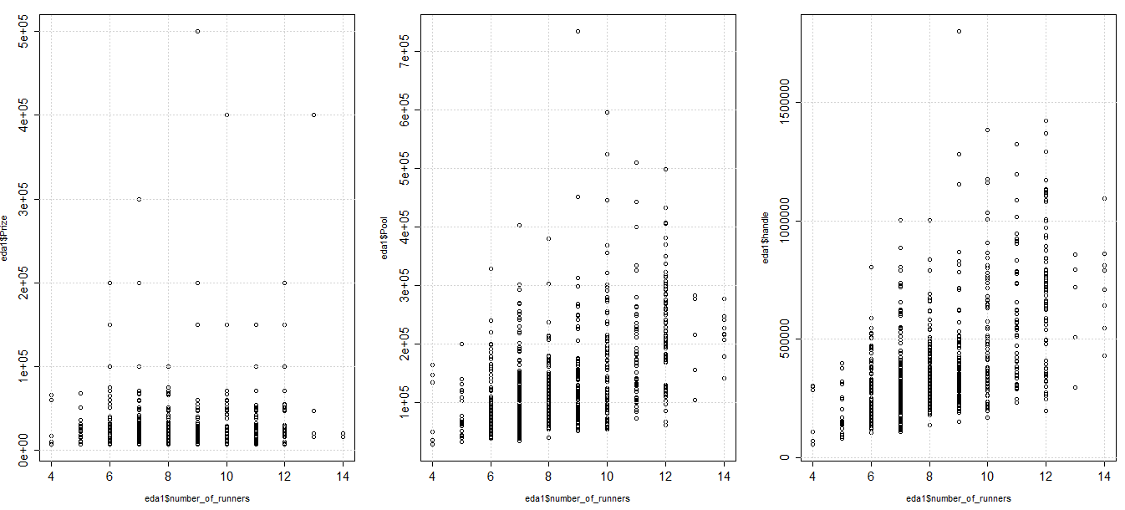
EDA: Horse Racing
Prize, Pool and handle are lesser in case of number of runners 4, 5, 13 and 14, and are higher in case of number of runners 9, 10, 11 and 12.
Note: Heights of the graphs are not proportionately scaled

Slide 24

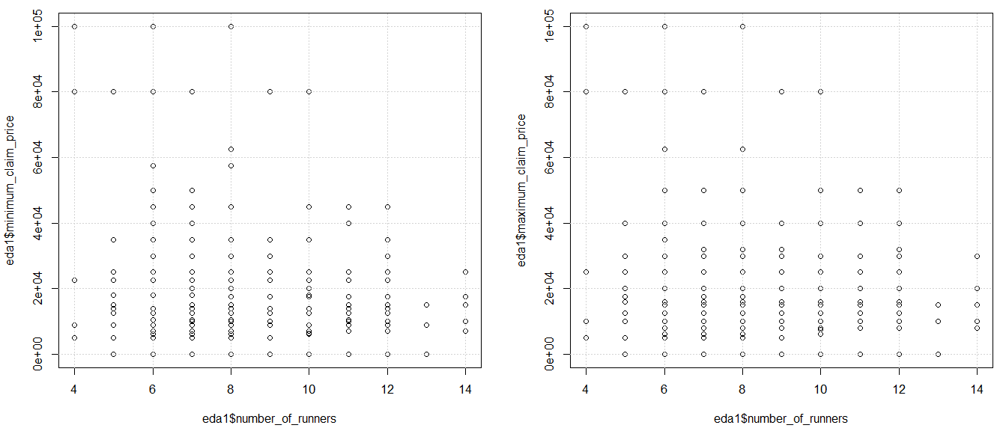
EDA: Horse Racing
minimum and maximum claim prices are relatively lower for number of runners 4, 11, 12, 13 and 14.

Slide 25
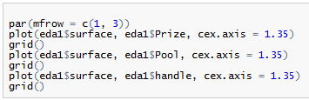
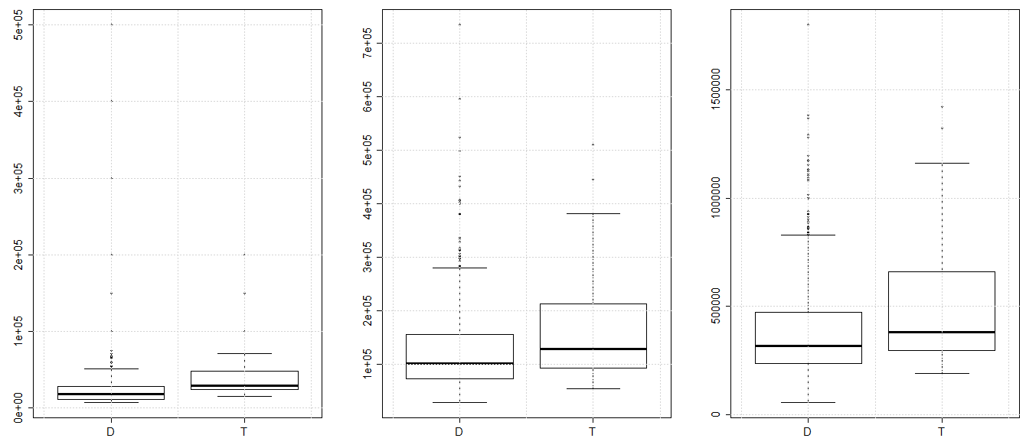
EDA: Horse Racing
Prize, Pool and handle are higher for Turf compared to Dirt surfaces.
Note: Heights of the graphs are not proportionately scaled

Slide 26

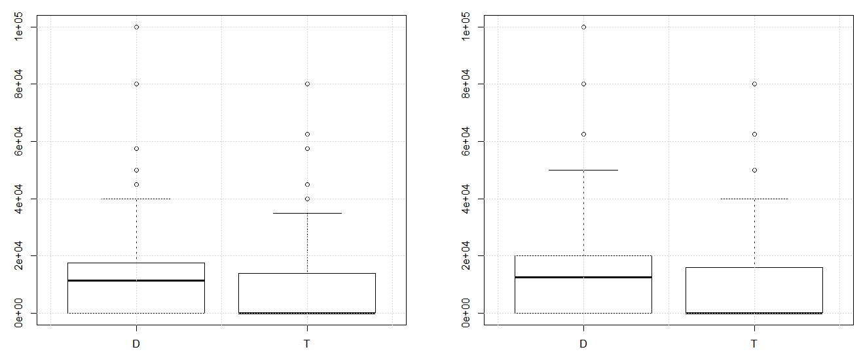
EDA: Horse Racing
Median minimum and maximum claim prices are zero for Turf.

Slide 27

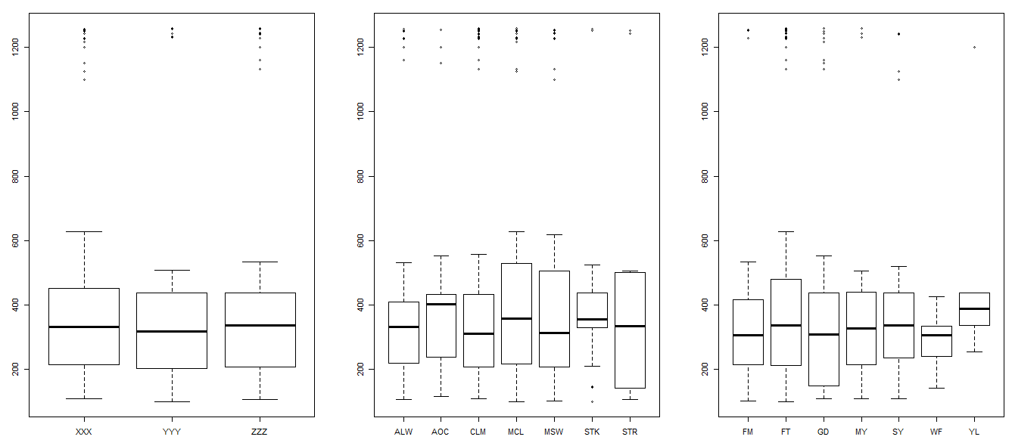
EDA: Horse Racing
Median post times are relatively similar in all cases (refer next two slides also). But in all cases there are few large extreme outlier datapoints.

Slide 28

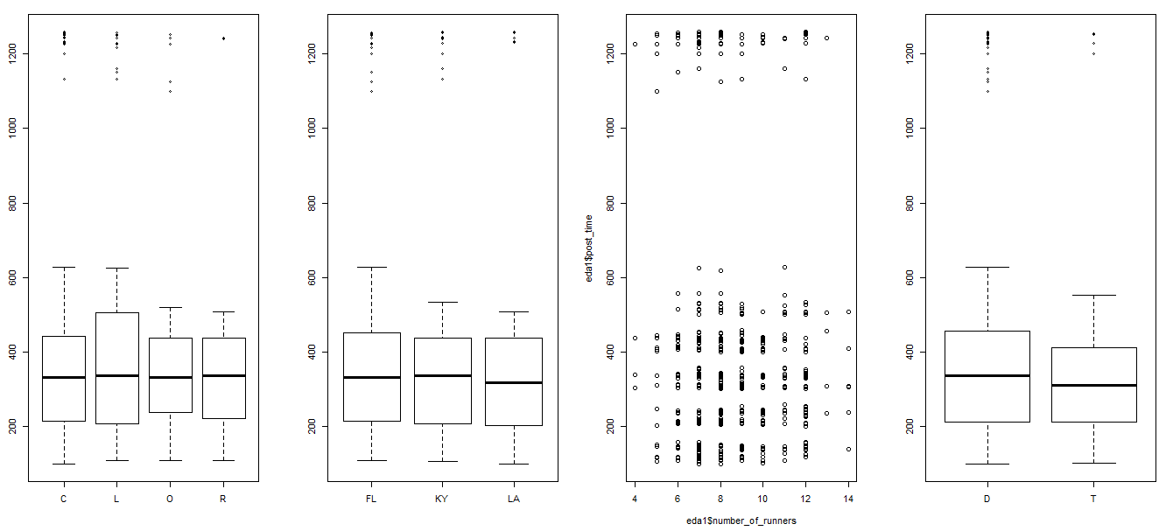
EDA: Horse Racing

Slide 29
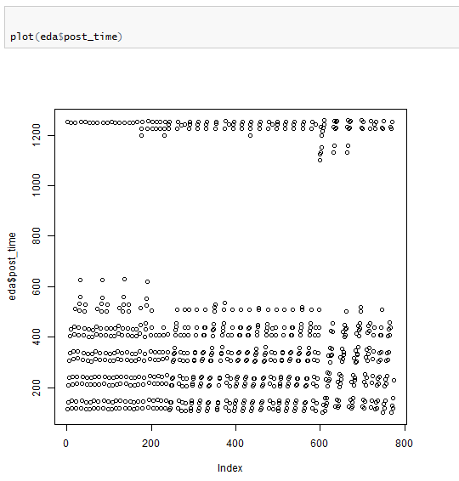
EDA: Horse Racing

Slide 30

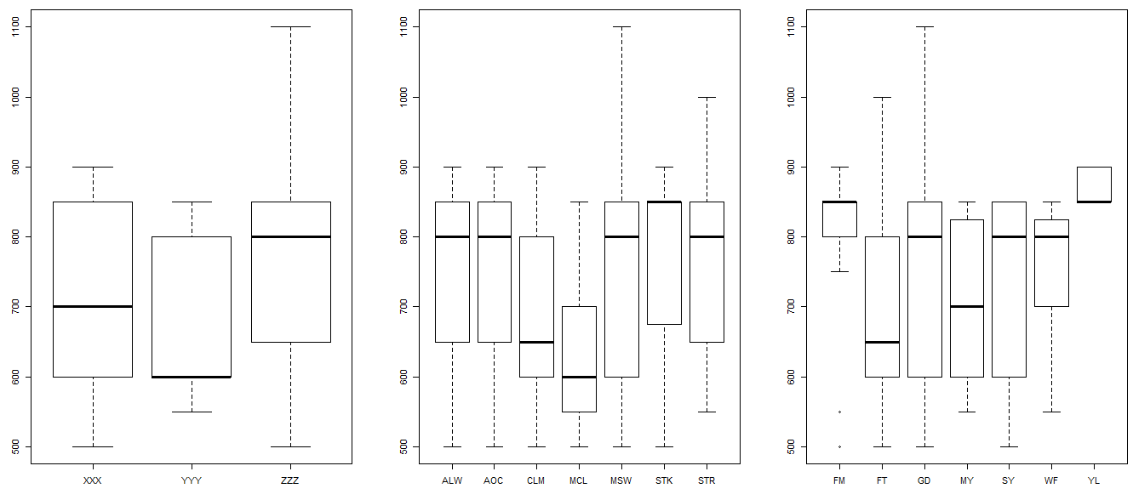
EDA: Horse Racing
Median distance seems relatively lesser for YYY track, maiden claim race type, “fast” surface type, clear and cloudy weather conditions and for state Lousiana
(refer next slide also)

Slide 31

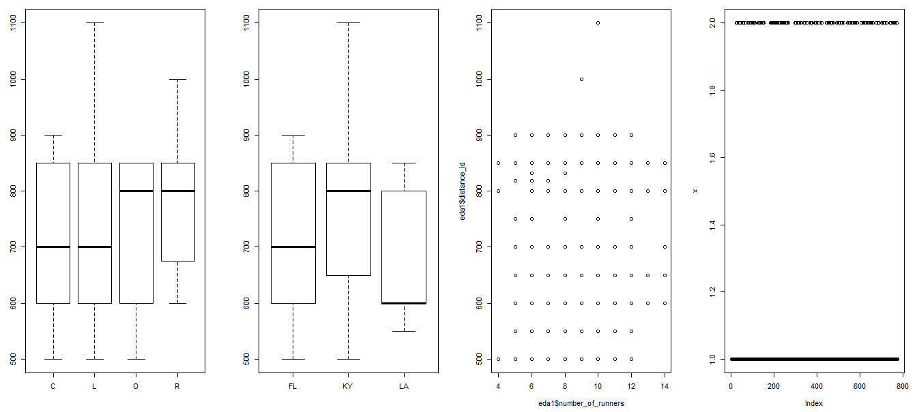
EDA: Horse Racing

Slide 32
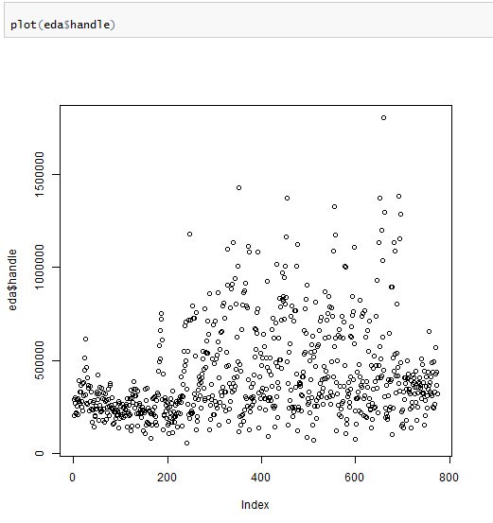
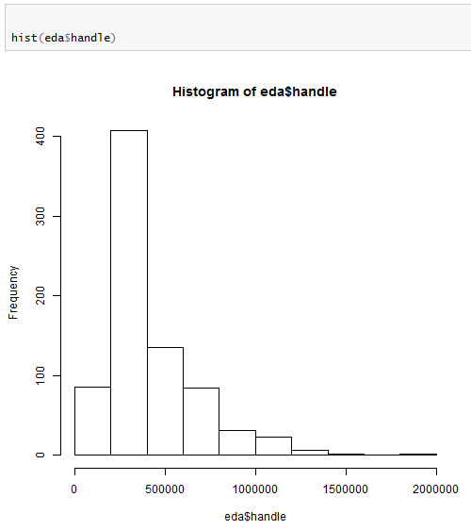
EDA: Horse Racing

Slide 33
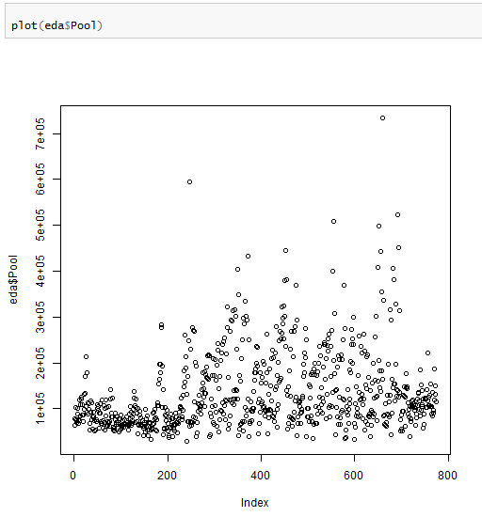
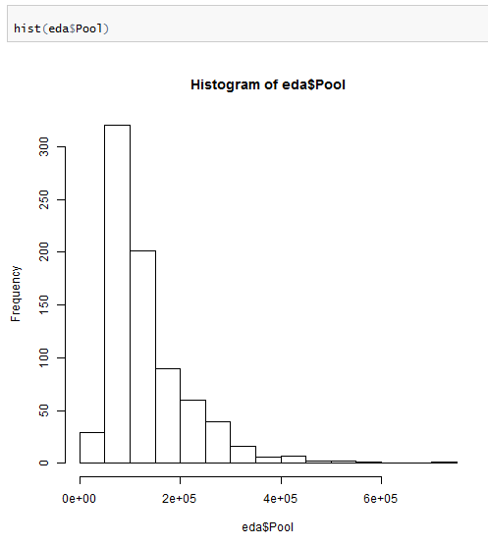
EDA: Horse Racing

Slide 34
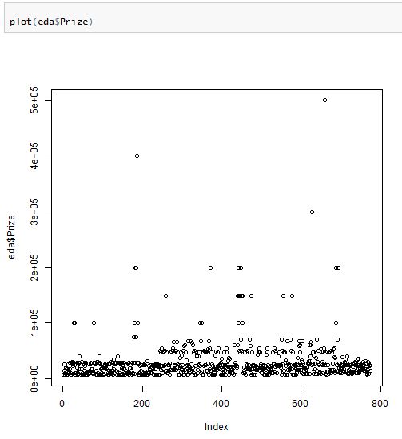
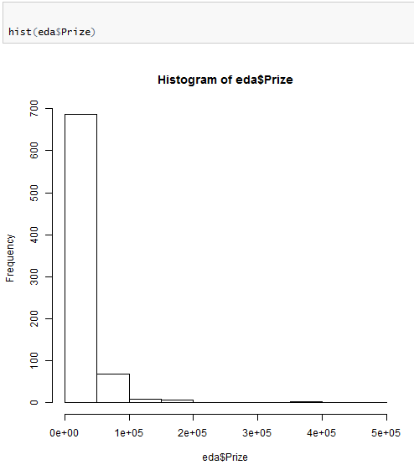
EDA: Horse Racing
There are few instances where prize is very high

Slide 35
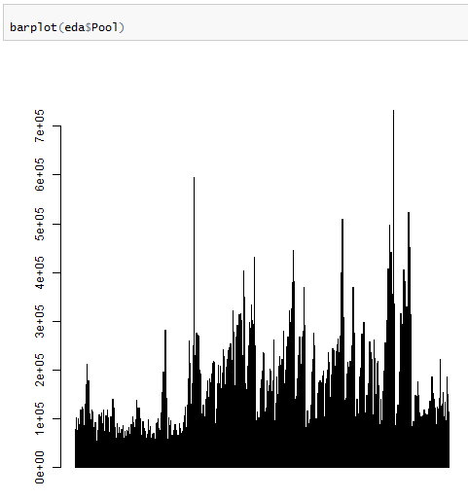
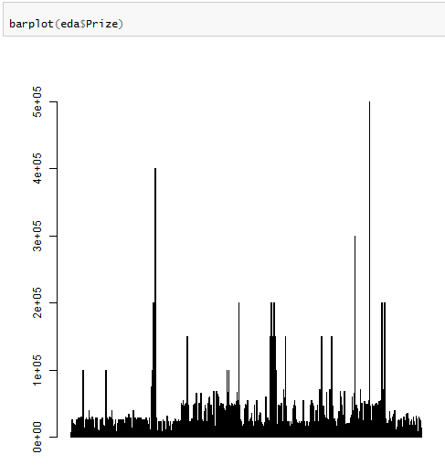
EDA: Horse Racing
There are few instances where prize is very high

Slide 36
Thank you

